Slide 1


Smart/Automate irrigation using soil moisture and weather data
Name: Nagula Lahari
AICTE Student ID: STU66422008326d31715609608
AICTE Internship ID: INTERNSHIP_1748923002683e727a876ea

Slide 2

Learning Objectives
Learn to preprocess and normalize sensor data for ML
Understand model training, evaluation, and deployment
Gain experience using Python libraries like pandas, NumPy, and scikit-learn
Learn to serialize models using joblib
Create a Streamlit web interface for real-time prediction
Explore how ML integrates with IoT in agriculture
Complete an end-to-end ML project lifecycle
GOAL
Source :
www.freepik.com/

Slide 3
Tools and Technology used
Python for development and scripting
Pandas and NumPy for data handling
Scikit-learn for model training and prediction
Joblib for saving/loading ML models
Streamlit for interactive web-based UI
Jupyter Notebook for testing and exploration
CSV dataset with 20 sensors used as input source

Slide 4
Methodology
Loaded and cleaned sensor dataset from CSV
Normalized values for consistent model performance
Split data into training and testing sets
Trained supervised classification model on sensor data
Serialized model using joblib for deployment
Built a web UI using sliders for user input
Predicted sprinkler status based on input values

Slide 5
Problem Statement:
Manual irrigation lacks efficiency and precision
Farmers use fixed schedules instead of real-time data
Leads to overwatering or underwatering of crops
Monitoring large fields manually is time-consuming
No intelligent feedback system for irrigation control
Environmental changes demand smarter irrigation methods
Need for a tech-driven, automated solution

Slide 6
Solution:
Smart system predicts ON/OFF sprinkler status using ML
Takes 20 sensor values as input via web app sliders
Provides real-time sprinkler control suggestions
Streamlit UI makes it easy for farmers to use
Model improves water efficiency and decision-making
Eliminates need for manual irrigation control
Scalable for various farm sizes and crop types
Github link :
https://github.com/Nagula-Lahari/Edunet-tasks/tree/main/edunet%20final

Slide 7
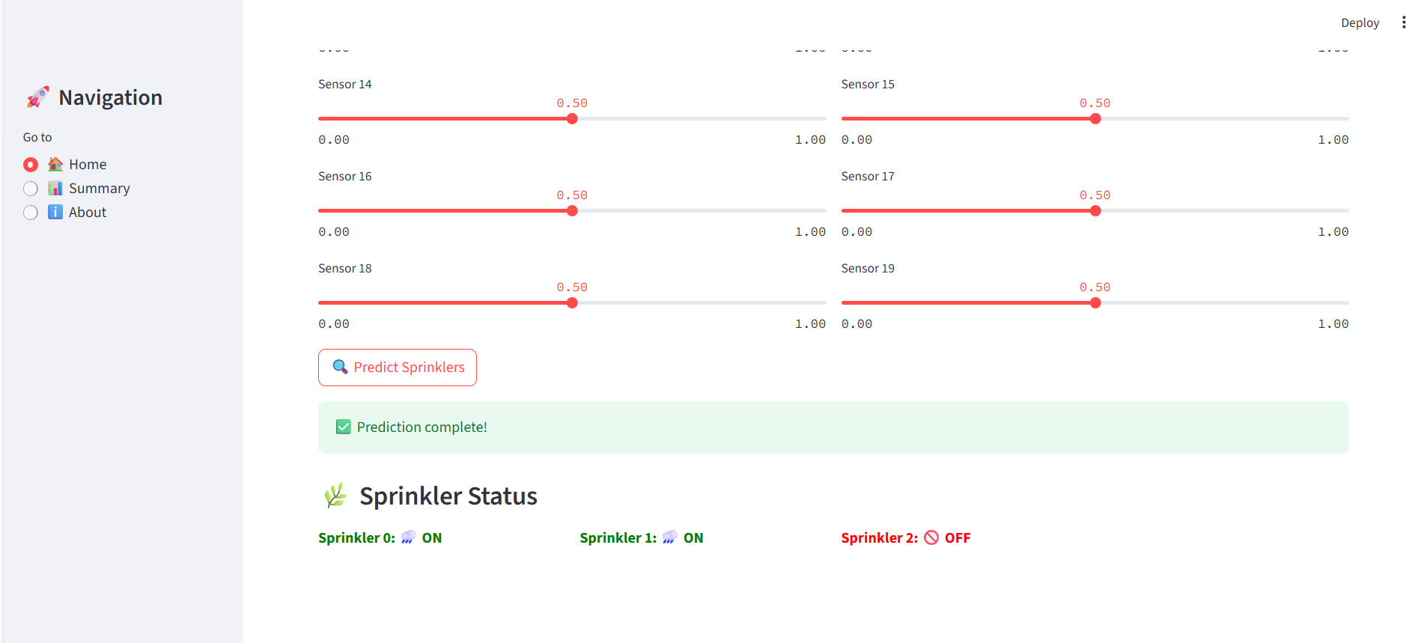
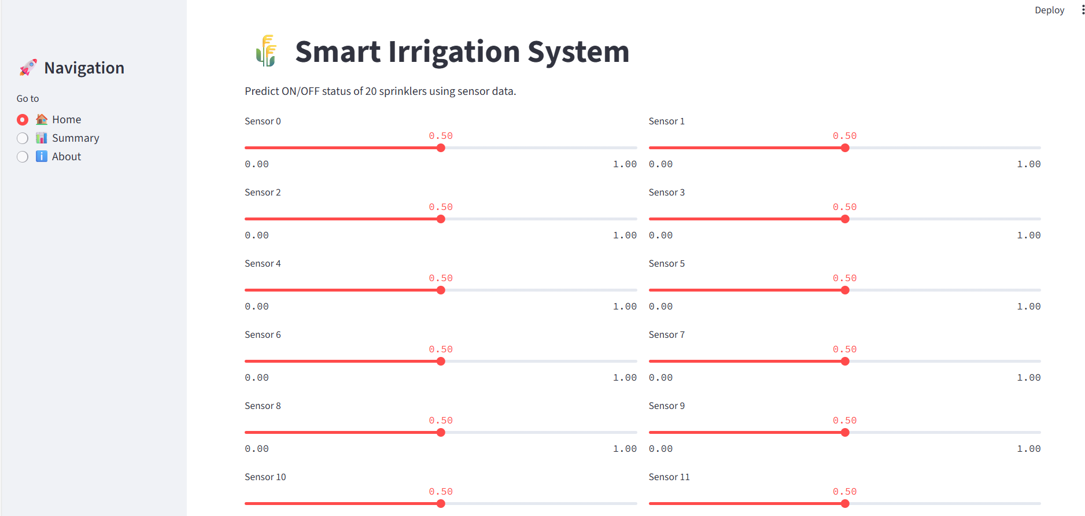
Screenshot of Output:

Slide 8
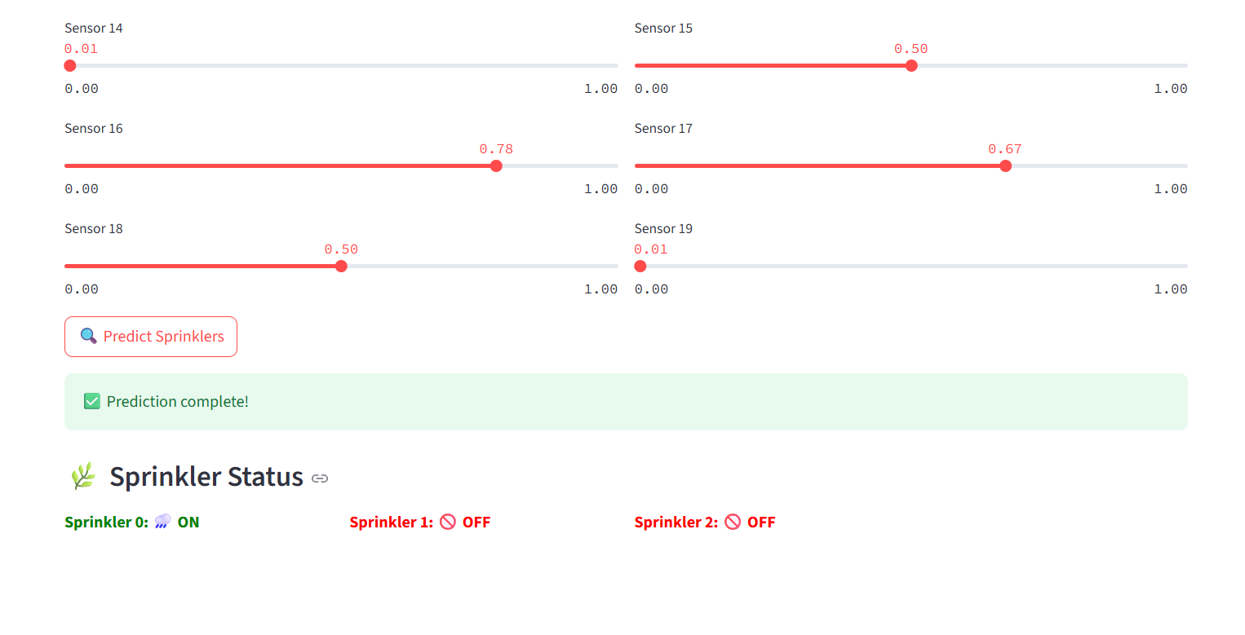
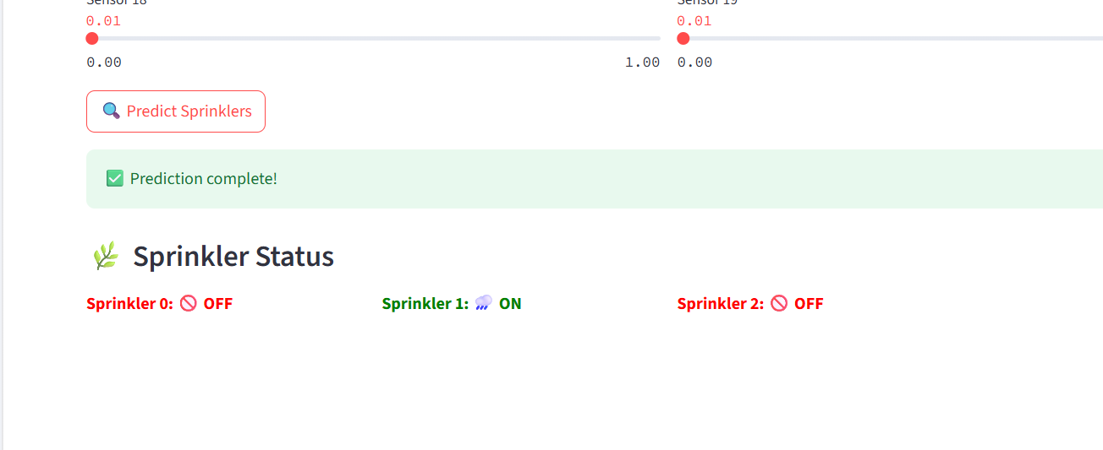

Slide 9
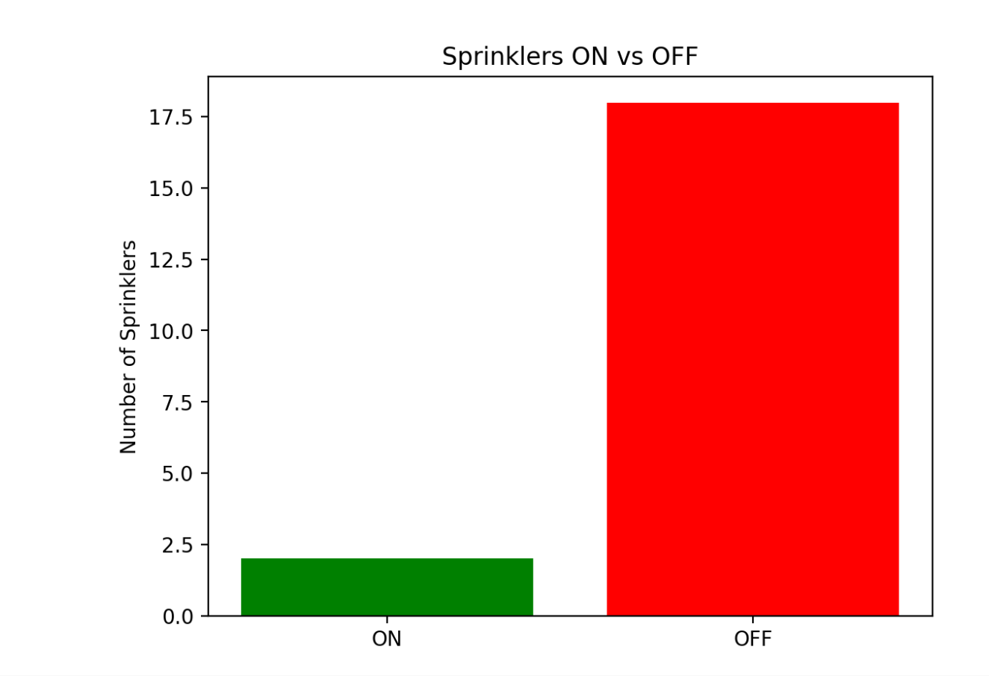
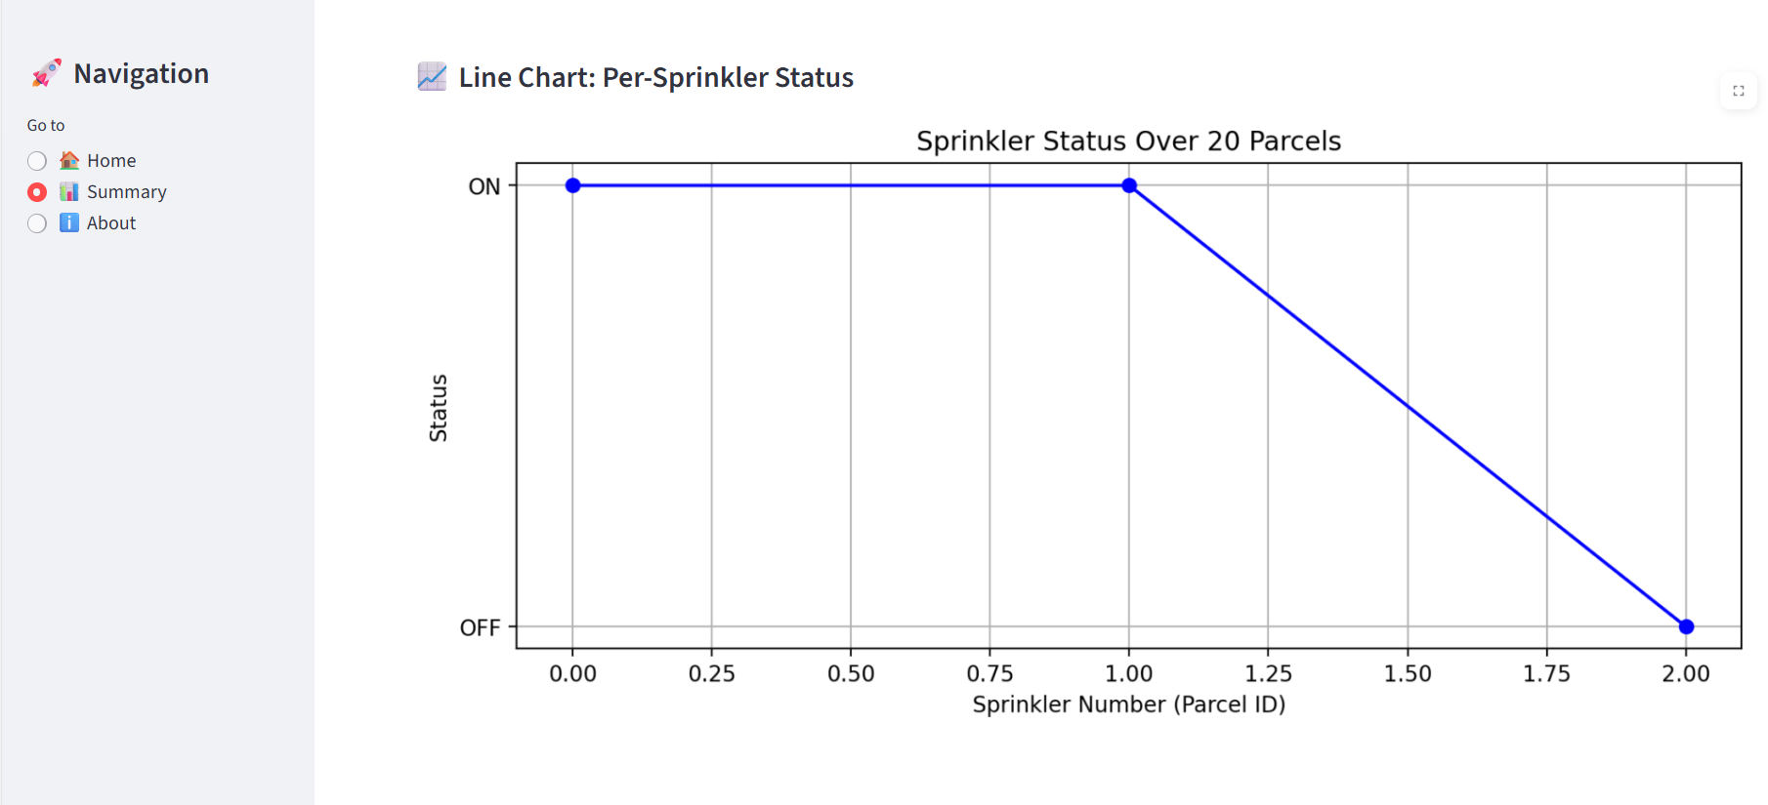
Screenshot of Output:

Slide 10
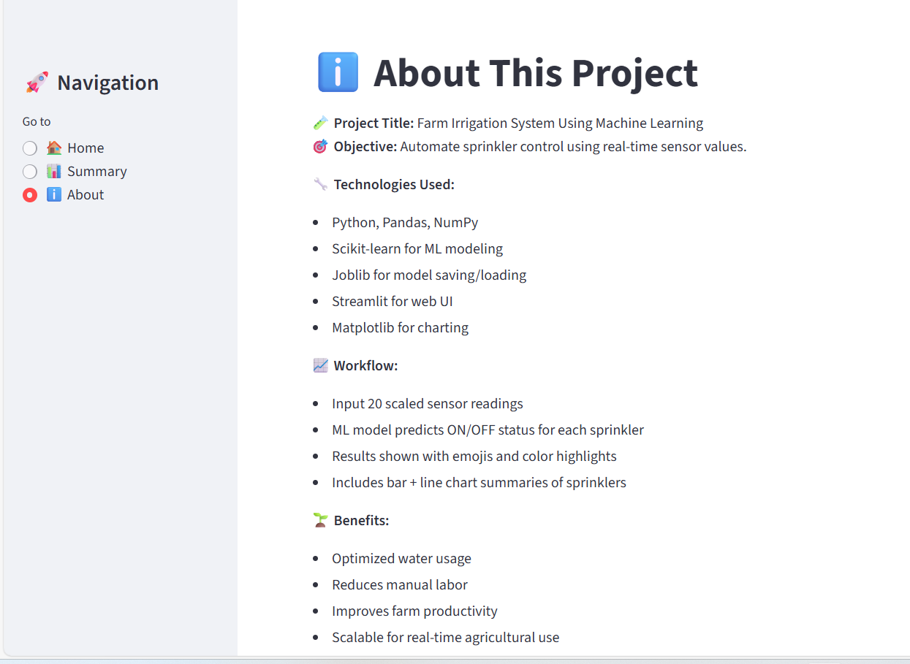
Screenshot of Output:

Slide 11
Conclusion:
Project proves ML can enhance agricultural efficiency
Reduces water use and manual labor with automation
Provides accurate, real-time irrigation decisions
Easy-to-use app suitable for non-technical users
Promotes sustainable and smart farming practices
Scalable, cost-effective, and field-ready solution
Strong example of AI applied to real-world problems

